Slide 1
SOFTWARE ENGINEERING
REVIEW
AGILE PRINCIPLES

Slide 2


GAME
BALL POINT GAME
X16
60 MIN
3 TEAMS OF 16 STUDENTS
RULES
Each ball must be touched by every team member
Each ball must have air-time between each member
Each ball must return to the first member (who pick up the ball)
Each ball cannot be passed to the left or right member
Any ball that falls on the floor or does not respect the rules is a defect.
https://play14.org/games/ball-point-game

Slide 3



Ball point game
DEBRIEF ABOUT AGILE VALUES :
Working as a team
Self-organization
Communication
Delivering value with high quality
Inspect and adapt
Iterative work
Estimates vs realizations

Slide 4
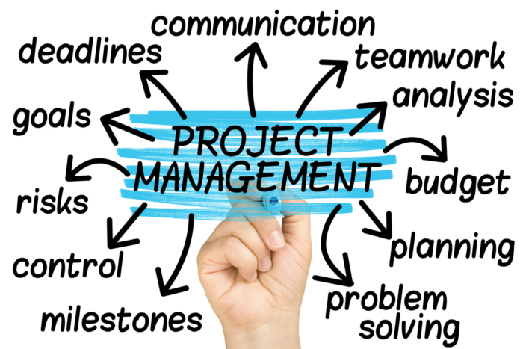
Project management is all about…

Slide 5






AGENDA
Who are the people involved in a project?
PROJECT LIFECYCLE
Why don’t the customer and developer think the same way?
What is a sprint?
What is a user story?
How do we break down a user story to sub tasks?
TEAM WORK
How do we work in a team?

Slide 6


AGENDA
Who are the people involved in a project?
PROJECT LIFECYCLE
Why don’t the customer and developer think the same way?
What is a sprint?
What is a user story?
How do we break down a user story to sub tasks?
TEAM WORK
How do we work in a team?

Slide 7
ACTIVITY
10 MIN
Who are the people involved in a web app project?
OUTSIDE THE COMPANY
INSIDE COMPANY

Slide 8



EXPLAIN
05 MIN
Who are the people involved in a web app project?
OUTSIDE THE COMPANY
INSIDE COMPANY
User
Customer
Project
Manager
Developers
Uses the project
Buys the project
Builds the project

Slide 9
AGENDA
Who are the people involved in a project?
PROJECT LIFECYCLE
Why don’t the customer and developer think the same way?
What is a sprint?
What is a user story?
How do we break down a user story to sub tasks?
TEAM WORK
How do we work in a team?

Slide 10
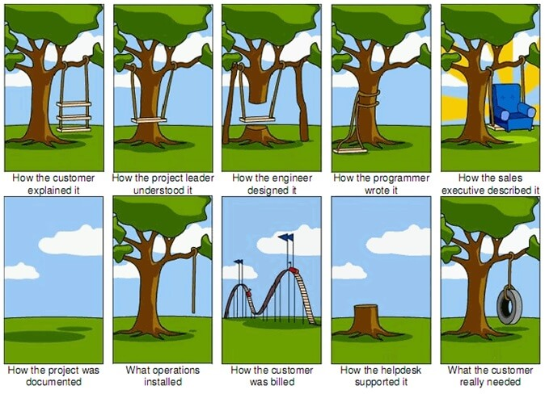
EXPLAIN
It’s hard to understand exactly the customer

Slide 11
WEATHER APP
What the IT team has created :
Cambodia Phnom Penh
15/01/2023 28 degree
REMOVE
France Paris
15/02/2023 05 degree
REMOVE
Cambodia Phnom Penh
16/01/2023 31degree
REMOVE
+
Cambodia Phnom Penh
17/02/2023 29 degree
REMOVE

Slide 12
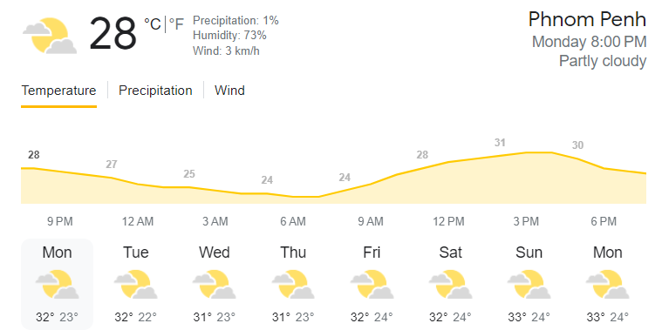
WEATHER APP
What the customer wanted :

Slide 13

ACTIVITY
10 MIN
What do you suggest to avoid customer disappointments?
Before coding
During coding
After coding

Slide 14
EXPLAIN
What do you suggest to avoid customer disappointments?
Before coding
During coding
After coding
Analyze the need
Validate design
Ask user to test
Design something

Slide 15




EXPLAIN
We need a process!!!
ANALYSE
DESIGN
PLAN
DEVELOP
TEST

Slide 16
AGENDA
Who are the people involved in a project?
PROJECT LIFECYCLE
Why don’t the customer and developer think the same way?
What is a sprint?
What is a user story?
How do we break down a user story to sub tasks?
TEAM WORK
How do we work in a team?

Slide 17
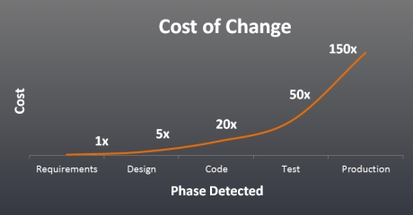
The more you wait, the more it costs

Slide 18
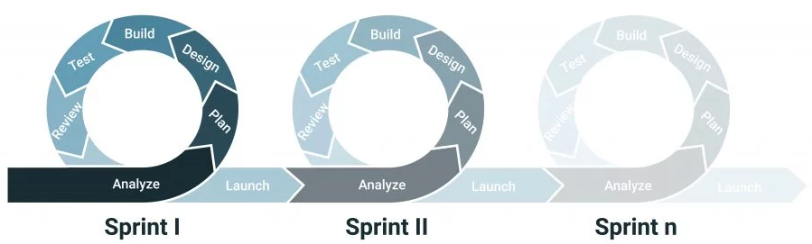



EXPLAIN
A sprint is a short time (a few weeks) with an objective for the team to produce a clear result

Slide 19

EXPLAIN
A sprint is composed of a list of features to bring to the application (the user stories) and bugs to fix
SPRINT 1
USER STORY
BUG
USER STORY
USER STORY

